Slide 1
UML Packages & Related Diagrams
Extending UML
Component
Deployment

Slide 2
Why extend UML?
Although UML is very well-defined, there are situations in which it needs to be customized to specific problem domains
UML extension mechanisms are used to extend UML by:
  adding new model elements,
  creating new properties,
  and specifying new semantics
There are three extension mechanisms:
  stereotypes, tagged values, constraints and notes

Slide 3
Stereotypes
Stereotypes are used to extend UML to create new model elements that can be used in specific domains
E.g. when modeling an elevator control system, we may need to represent some classes, states etc. as
  «hardware»
  «software»
Stereotypes should always be applied in a consistent way

Slide 4
Stereotypes (cont.)
Ways of representing a stereotype:
  Place the name of the stereotype above the name of an existing UML element (if any)
    The name of the stereotype needs to be between «» (e.g. «node»)
    Don’t use double ‘<‘ or ‘>’ symbols, there are special characters called open and close guillemets
  Create new icons
Stereotype
Stereotype
in form of icon
«button»
CancelButton
❑
state
CancelButton

Slide 5
Tagged Values
Tagged values
  Define additional properties for any kind of model elements
  Can be defined for existing model elements and for stereotypes
  Are shown as a tag-value pair where the tag represent the property and the value represent the value of the property
Tagged values can be useful for adding properties about
  code generation
  version control
  configuration management
  authorship
  etc.

Slide 6
Tagged Values (cont.)
A tagged value is shown as a string that is enclosed by brackets {} and which consists of:
  the tag, a separator (the symbol =), and a value
Two tagged values
{author = “Bob”,
Version = 2.5}
Employee
name
address

Slide 7
Constraints
used to extend the semantics of UML by adding new rules, or modifying existing ones.
can also be used to specify conditions that must be held true at all times for the elements of a model.
can be represented using the natural language or OCL (Object Constraint Language)

Slide 8
Comments
Comments are used to help clarify the models that are being created
  e.g. comments may be used for explaining the rationale behind some design decisions
A comment is shown as a text string within a note icon.
A note icon can also contain an OCL expression
Abstraction-occurrence pattern
1..*
Title
Copy

Slide 9
UML Profiles
UML Profiles provide an extension mechanism for building UML models for particular domains
  e.g. real-time systems, web development, etc…
A profile consists of a package that contains one or more related extension mechanisms (such as stereotypes, tagged values and constraints)
  that are applied to UML model elements
Profiles do not extend the UML metamodel. They are also called the UML light-weight extension mechanism

Slide 10
UML Profiles (cont.)
A UML profile is a specification that does one or more of the following:
  Identifies a subset of the UML metamodel (which may be the entire UML metamodel)
  Specifies stereotypes and/or tagged values
  Specifies well-formedness rules beyond those that already exist
  Specifies semantics expressed in natural language

Slide 11
Example of a profile inspired by the research report of Cabot et al. (2003)
We would like to create a UML profile for representing basic GUI components.
We suppose that our GUI contains the following components:
  Forms (which can also be dialog boxes)
  Buttons
Constraints: (in practice, we need to be more precise)
  A form can invoke a dialog box
  A form as well as a dialog box can contain buttons

Slide 12
The GUI profile package
Class and Association are part of UML metamodel
GUI Profile
Class
Association
<<stereotype>>
Form
<<stereotype>>
Button
<<stereotype>>
Contains
<<stereotype>>
Invokes
<<stereotype>>
DialogBox

Slide 13
Instance Diagram of the GUI Profile
<<Form>>
MainView
1
<<Invokes>>
1
<<DialogBox>>
OpenDialogBox
1
1
<<Contains>>
<<Contains>>
1
1
<<Button>>
OkButton
<<Button>>
CancelButton

Slide 14
Drawing Subsystems in UML
System design must model static and dynamic structures:
  Component Diagrams for static structures
    show the structure at design time or compilation time
  Deployment Diagram for dynamic structures
    show the structure of the run-time system

Slide 15
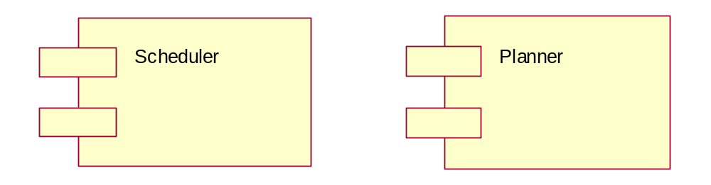
Component
Component:
A component is a named physical and replaceable part of a system that represents physical packaging of otherwise logical elements and that conforms to, and provides the realization of, one or more interfaces.
A component type represents a piece of software code (source, binary, or executable)
  A component type has a type name
A component instance represents a run-time code unit
  A component instance has a name and a type (component-name : component-type)
A component is represented as a rectangle with two small rectangles protruding from its side

Slide 16
Component
Component:
Physical packaging of model elements
- Source, binary, executable, configuration, makefile, IDL bindings, etc.
- Aggregate of other components
Standard stereotypes
- <<executable>> - a program that may run on a node
- <<application>> - consists of several executables
- <<file>> - file containing source code or data
- <<library>> - static or dynamic library
- <<document>> - a document
- <<page>> - HTML page
- technology specific
  <<ActiveX>>, <<JavaBean>>, <<Applet>>, <<DLL>>, <<CORBA Component>>

Slide 17
Component
Modelling Elements: Components
Basic
  Class
  Object
  Interface
  Collaboration
  Use-case
  Active Class
  Component
  Node
Classes are basic model elements.
Class names are shown in boldface type.
Abstract classes are shown in italic.
Object (Class Instance) are shown by class elements with underlined names.
Interfaces are indicated by lollipops.
Collaborations are indicated by dashed ovals. (They realize use-cases).
Use-case is shown by ellipse.
Active classes are shown by thick bordered class boxes.(They represent independent thread of processing).
A Component is a combination of one or more classes that forms a physical software element.
A Node is a processor or hardware device.
A Composite Model element is a package or a subsystem of base or composite elements.
Composite
  Package

Slide 18
Component Diagram
Component Diagram
  A graph of components connected by dependency relationships.
  Shows the dependencies among software components
    source code, linkable libraries, executables
  has only a type form, not an instance form
Dependencies are shown as dashed arrows from the client component to the supplier component.
  The kinds of dependencies are implementation language specific.

Slide 19
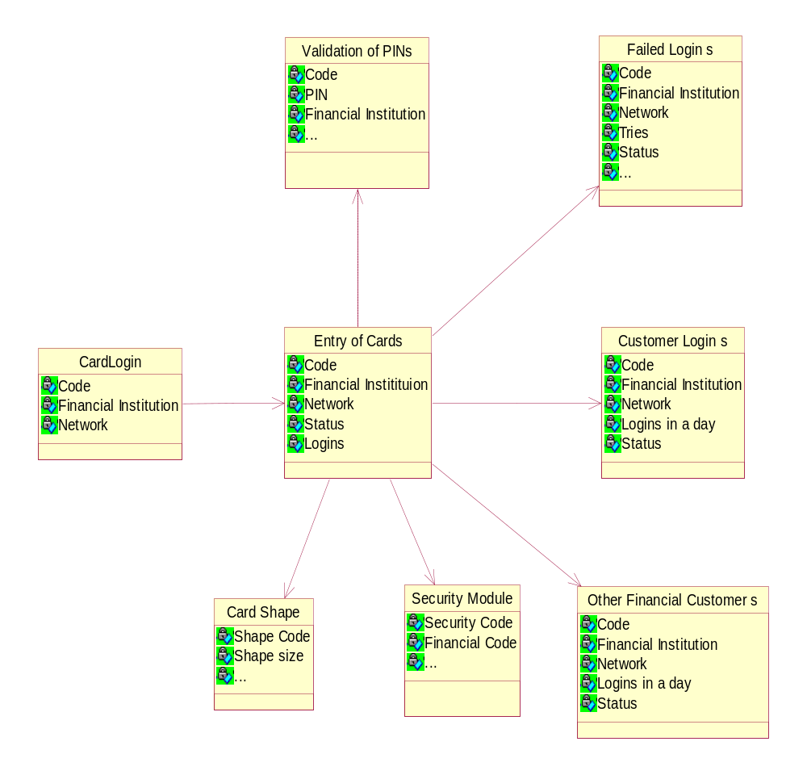
Use Case to Implementation
Use Cases are eventually realized as components (Code)
Components of the Implementation
trace
<<file>>
Failed Logins
<<page>>
GUI/ Slide Entry
trace
<<executable>>
entry of cards

Slide 20
Component Diagram
Component Characteristics
Components trace to the model elements they implement (hence all the way back to use cases)
A Component usually implements several elements
Components provide the same interface as the model elements they implement
Compilation dependencies denote which elements are required to compile a specific component
Implement component stubs to ease compilation, integration and test

Slide 21
Component Diagram Example
Scheduler
reservations
UML Component
UML Interface
Planner
update
GUI

Slide 22
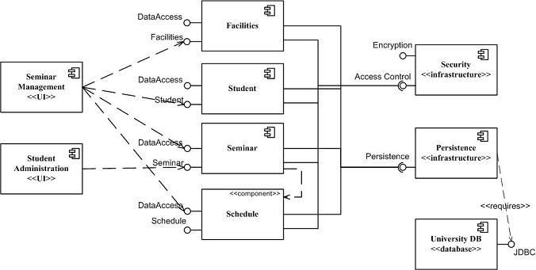
UML 1.x vs. 2.x
Component Diagrams
UML 2.0

Slide 23
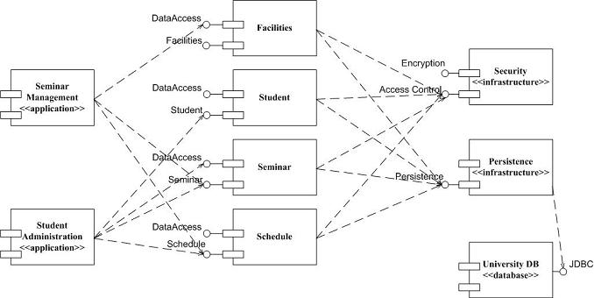
UML 1.x vs. 2.x
Component Diagrams
UML 1.x

Slide 24
UML 1.x vs. 2.x
Component Diagrams
Notational differences:
UML 2 components are modeled as simple rectangles
  uses this symbol as a visual stereotype within the rectangle
UML 1.x there were depicted as rectangles with two smaller rectangles jutting out from the left-hand side. As you can see
Both diagrams model dependencies, either between components or between components and interfaces.
  both diagrams use the lollipop symbol to indicate an implemented interface
    the UML 2 version introduces the socket symbol to indicate a required interface.

Slide 25
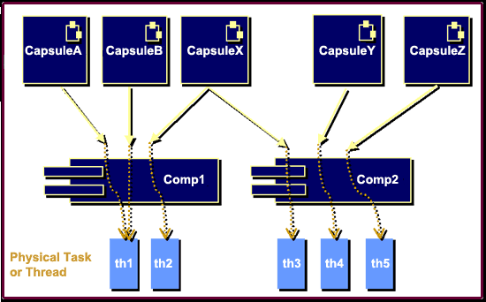
Example: Multitasking

Slide 26
Example: Multitasking
Each capsule (i.e., active class) has its own independent thread of control that is implemented using its state diagram.
  can be mapped to a specific component (or set of components), which can then be built as an executable library or external library.
Each component implements a non-trivial set of functionality
  may not necessarily be a single unit of code or a single binary.
System architects can use both capsules and components to depict units of distribution, assembly, and deployment.

Slide 27
Deployment Diagram
Deployment diagrams show the configuration of run-time processing elements and the software components, processes, and objects that live on them. Software component instances represent run-time manifestation of code units.
Components that do not exist as run-time entities do not appear in Deployment diagrams.

Slide 28
Deployment Diagram
Deployment diagrams are useful for showing a system design after the following decisions are made
  Subsystem decomposition
  Concurrency
  Hardware/Software Mapping
A deployment diagram is a graph of nodes connected by communication associations.
  Nodes are shown as 3-D boxes.
  Nodes may contain component instances.
  Components may contain objects (indicating that the object is part of the component)

Slide 29
Deployment Diagram
A deployment diagram is a graph of nodes connected by communication associations. Nodes may contain component instances; indicates “Component” run on nodes.
Components may contain objects; indicates “Objects” is part of the component.
Components are connected to other components by dashed-arrow dependencies.

Slide 30
Deployment Diagram
A Deployment Diagram shows the actual Hardware configuration consisting of
  Nodes (processors)
  Software - Components
  Processes
  Objects

Slide 31
Deployment Diagram
Sample Deployment Diagram
This diagram shows 3 machines: 2 PC workstations running
WebLogic and a Mainframe running the ODSs in DB2
<<Buildmaster Workstation>>
<<WIN2000 on 1 Ghz PIII>>
PC:Win2000 on Intel
WebLogic W(dev) Server: WLS Managed
Server
<<WLS Instance: Port
administer SSL
<<WLS Instance: Port 8888>>
8888>>
Admin Domain:WLS 6.1
Admin Domain:WLS 6.1
Admin Server
Admin Server
administer
Text
<<WL Instance: Port 7001>>
<<Web
Team's Server: WLS 6.1
<<Mainframe>>
Browser>>
DB2 UNT: SYS D
IE 5.5
Text
<<Enterprise
<<database>>
Application>>
Claim:ODS
JDG.ear
get data
<<database>>
Text
PA&R:ODS
<<database>>
Login:ODS

Slide 32
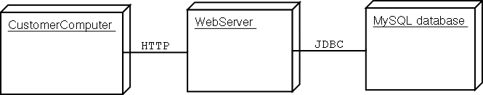
Deployment Diagram
  Captures the distinct number of computers involved
  Shows the communication modes employed
  Component diagrams can be embedded into deployment diagrams effectively…

Slide 33
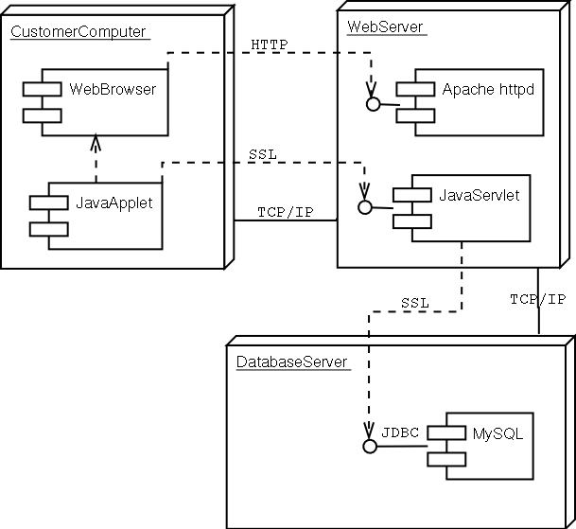
Deployment Diagrams
Note embedded component diagrams

Slide 34
Deployment Diagram Example
Compile Time
Dependency
:HostMachine
<<database>>
meetingsDB
:Scheduler
Runtime
Dependency
:PC
:Planner

